Slide 1









Institute of Engineering & Technology, Lucknow
Movie Recommendation System
Presented by
Supervised by
Apoorv Bansal
(1805213013)
Uttam Singh
(1805213062)
Vanshika Gupta
(1805213063)
Pf. Nathan Singh
Pf. Sandeep Yadav
Submitted for the partial fulfillment of
B.Tech in
Information Technology
Department of Computer Science & Information Technology
May 2022
1

Slide 2

Content
Abstract
Objectives
Introduction
Tools and technologies
Flow Chart
Steps of Implementation
Future works
Conclusion
References
Movie Recommendation System
May 2022
2
2

Slide 3
1. Abstract
On the Internet, where the number of choices is overwhelming, there is need to filter, prioritize and efficiently deliver relevant information in order to alleviate the problem of information overload, which has created a potential problem to many Internet users. Recommender systems solve this problem by searching through large volume of dynamically generated information to provide users with personalized content and services.

Slide 4



2. Objective
To create a movie recommendation system using Collaborative Filtering and machine learning algorithms such as K Nearest Neighbours.
The system should recommend movies based on the movie title entered by the user.
The system should also be able to recommend movies on the basis of 'genre only' and 'genre and year' entered.
The system should apply sentiment analysis to categorize user comments on a particular movie.
Additional Content Based Filtering is performed using Neural Network to perform Matrix Factorization.

Slide 5

3.Introduction
System that seeks to predict or filter preferences according to the user's choices.
Recommender systems encompass a class of techniques and algorithms that can suggest “relevant” items to users.
Types of Recommendation System
Content- based Recommendation System
Collaborative- based Recommendation System
Hybrid based Recommendation System

Slide 6
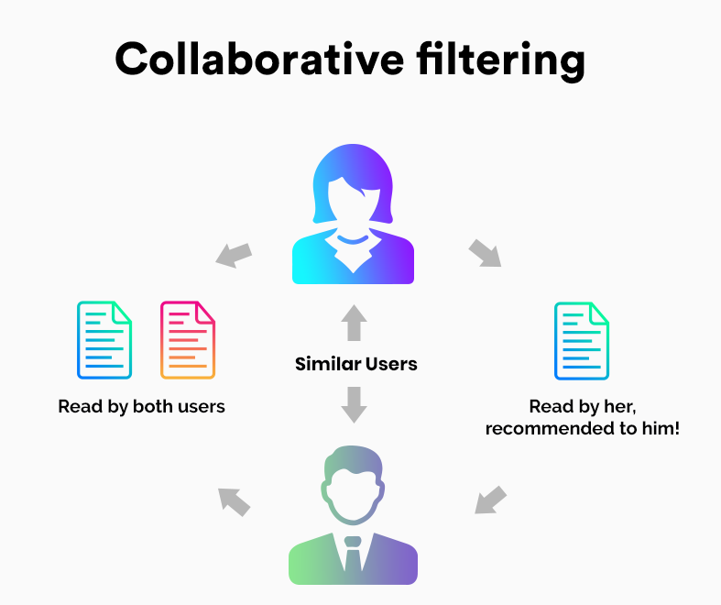
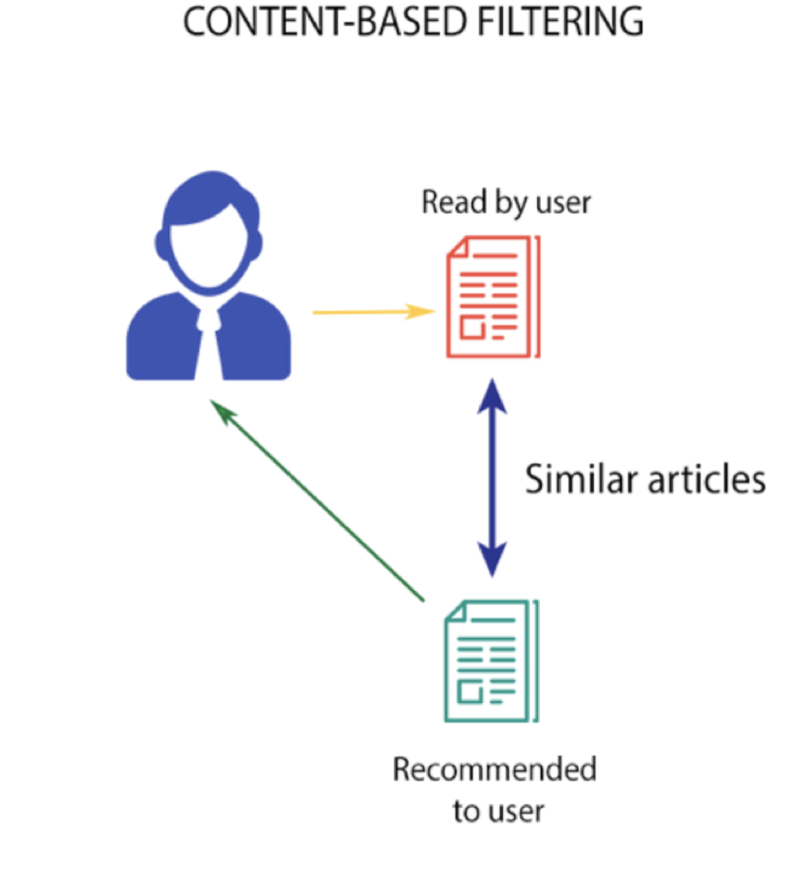
3. Introduction
Limitations of Content- based Recommendation System
This technique requires a lot of domain knowledge.
The model has limited ability to expand on the users' existing interests.
Limitations of Collaborative- based Recommendation
System
Data Sparsity
Scalability
Cold-Start Problem

Slide 7
4. Tools and technologies
Collaborative filtering
Cosine Similarities
machine learning algorithms, K Nearest Neighbours.
Sentiment analysis
Matrix Factorization.
Neural Network

Slide 8

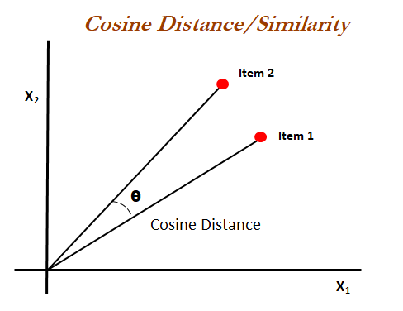
4.Tools and Technologies
NearestNeighbors (metric='cosine',algorithm='brute')
Here, metric to use for distance computation between points.
Cosine Similarity
Cosine similarity is a metric used to measure how
similar two items are.
0 - no similarity
1 - 100% similar.
This parameter will take the algorithm (BallTree, KDTree or Brute-force) you want to use to compute the nearest neighbors.

Slide 9
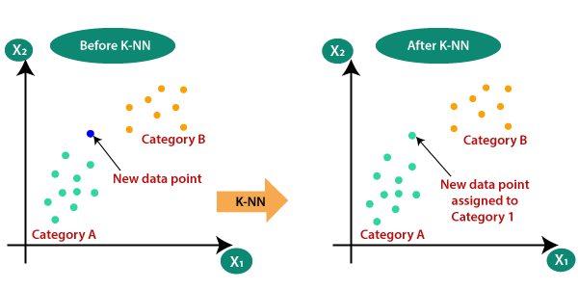
4. K Nearsest Neighbours
The k-nearest neighbors algorithm, also known as KNN or k-NN, is a non-parametric, supervised learning classifier, which uses proximity to make classifications or predictions about the grouping of an individual data point.

Slide 10
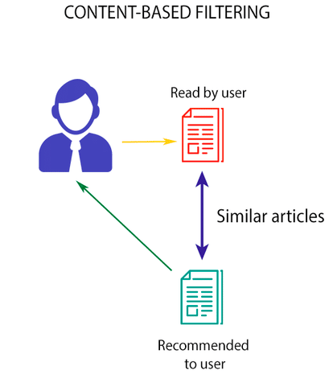
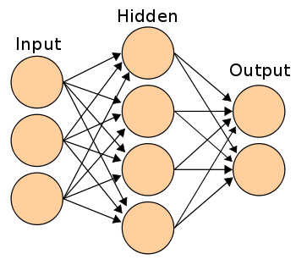
4.Tools and Technologies
Neural Networks
To overcome Cold Start Problem
Content Based uses Neural Networks
To find linear relation between input and output
Neural Networks

Slide 11

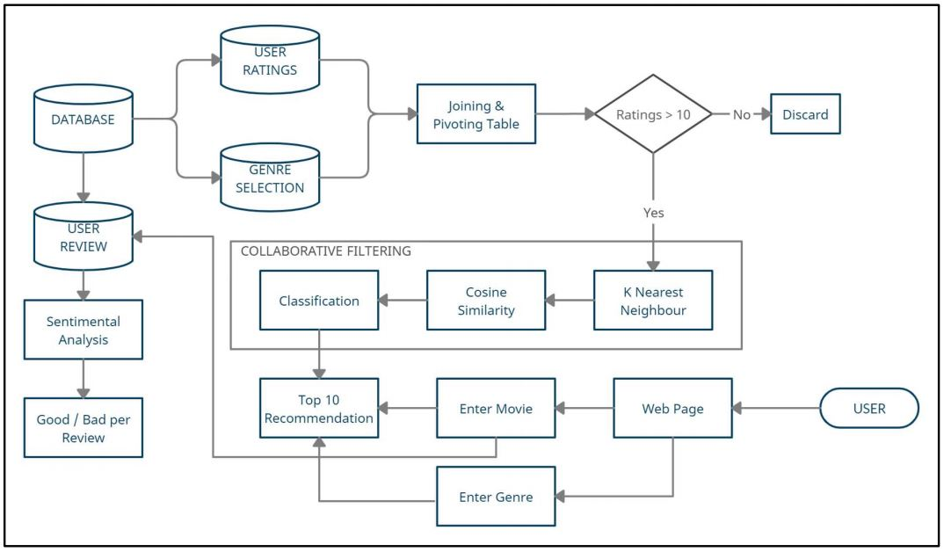
5.Flow Chart

Slide 12

6.Implementaion
Apply Collaborative Filtering to find similar movies based on ratings stored in ratings.csv file.
K-NN Algorithm to find nearest neighbours.
Apply Neural networks for content- based recommedation based on users past experiences.
Sentimental Analysis is used to extract the information from reviews.

Slide 13
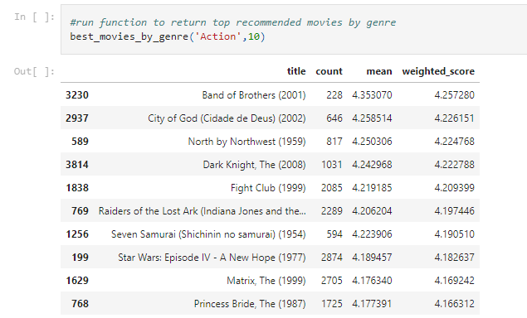
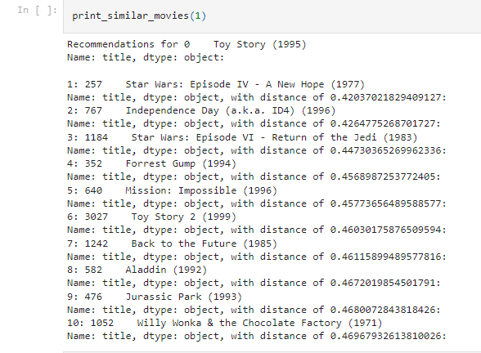
Get Movies By Genre Get Movies based on Cosine similarity
Distance using Cosine
Similarity

Slide 14
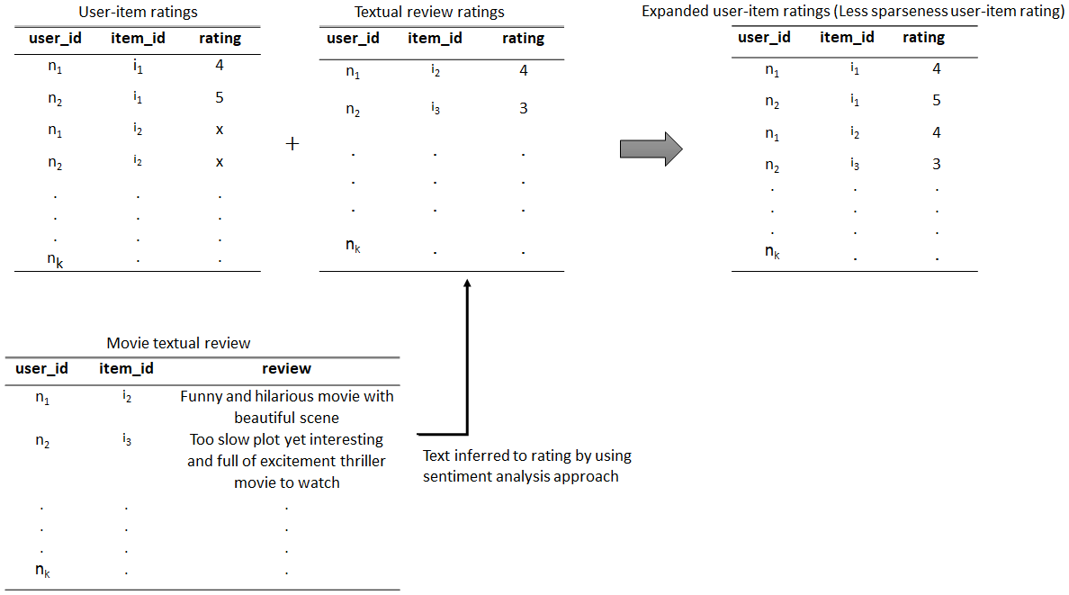
Sentimental Analysis
Algorithm Used -> Naives bayes and Support VectorMachine

Slide 15
7.Future Work
Apply Sentimental Analysis.
Deep Learning
Deep Learning is similar to matrix factorization, in that there is an ability to derive latent attributes.
Deep Learning, however, can make up for some of the weaknesses of matrix factorization such as the inability to include time in the model.

Slide 16
8. Conclusion
Basically project consist of mainly 2 parts
First , focuses on the movie recommendation part
Collaborative-based and content-based used
and Second , focuses on the sentimental analysis part.
For movie recommendation part , we uses cosine similarity which
uses angular area between the vectors to find the similarity score.
Sentimental analysis plays a vital role in the study. It aims to classify
the user’s review as positive and negative.

Slide 17
8. References
Research and Development of Movie Social System, Qiu BinLiuShengGaoBi FengGuo (2020).
D.L. Vu, T.K. Nguyen, T.V. Nguyen, T.N. Nguyen, F. Massacci, P.H. PhungHIT4Mal: Hybrid image
transformation for malware classification Transactions on Emerging Telecommunications
Technologies, 31 (11) (2020), p. e3789
Asabere N. Y., Acakpovi A., and Michael M., "Improving Socially-Aware Recommendation
Accuracy Through Personality," IEEE Transactions on Affective Computing, 2017.
S. Koshiyama, N. Firoozye, and P. Treleaven, “A derivatives trading recommendation system: the mid‐curve calendar spread case,” Intelligent Systems in Accounting, Finance and Management, vol. 26, no. 2, pp. 83–103, 2019.
S. Wan, X. Li, Y. Xue, W. Lin, and X. Xu, “Efficient computation offloading for Internet of Vehicles in edge computing-assisted 5G networks,” The Journal of Supercomputing, vol. 76, pp. 2518–2547, 2020.
S. Sharma, V. Rana, M. Malhotra Automatic recommendation system based on hybrid filtering
algorithm Education and Information Technologies (2021), pp. 1-16

Slide 18
THANK YOU

